Slide 1
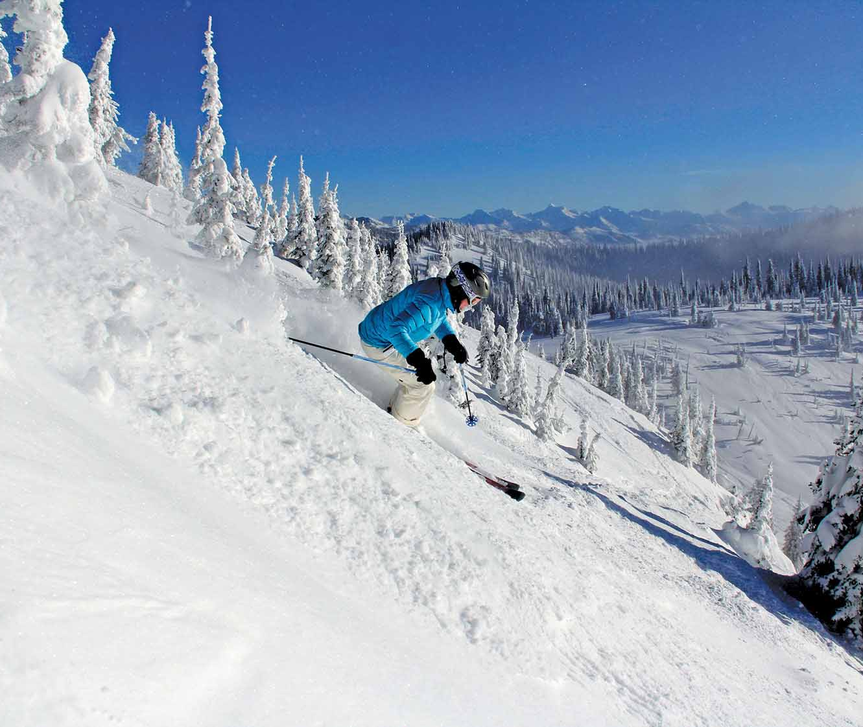
Big Mountain Resort
Facilities and Revenue Analysis

Slide 2
Topic for Today
We understand that Big Mountain Resort has an additional chair lift increasing the distribution of visitors across the mountain. This also increases operations by $1.5M. Your current pricing model is charging a premium above market-rate, However, it is quite possible that BMR isn’t capitalizing on the facilities as much as it could.
The following slides will help you answer this main question:
Can Big Mountain Resort improve on their (now) 12 facilities by increasing the amount of fast chairlifts (and reducing the amount of single chairlifts) to accommodate more visitors, opening the resort more days out of the year, increasing the amount of snow machines, or other ways without increasing the value of the ticket price or justify an even higher ticket price for its visitors to supplement the additional cost of $1.5M for this next winter season?

Slide 3
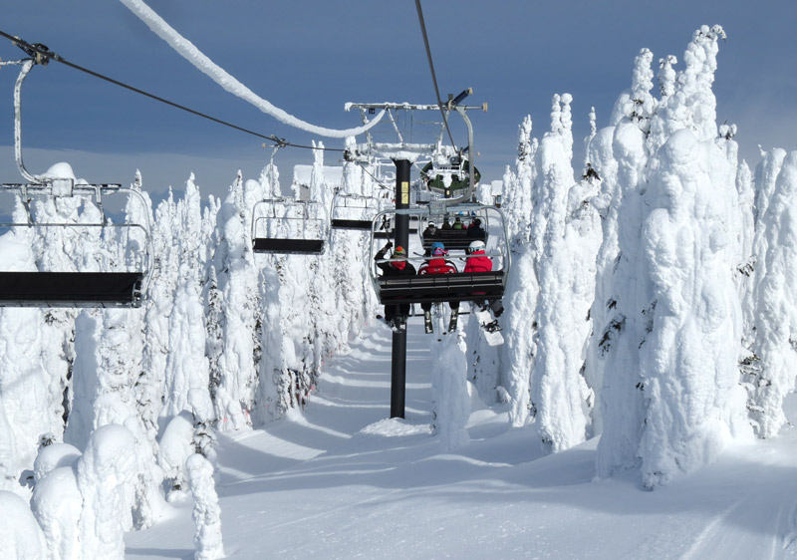
Key Findings & Recommendations
Key Findings
Big Mountain Resort’s:
Facilities are above average
Current price is undercharging by $10
Three Recommended Scenarios
Keep facilities the same and charge $91 per ticket
Close one run and charge $91 per ticket
Add another run and charge $99 per ticket

Slide 4
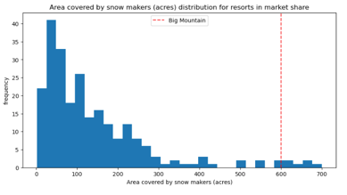
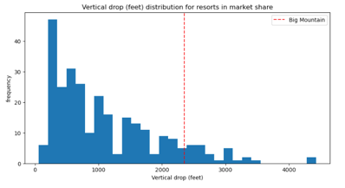
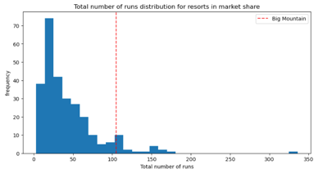
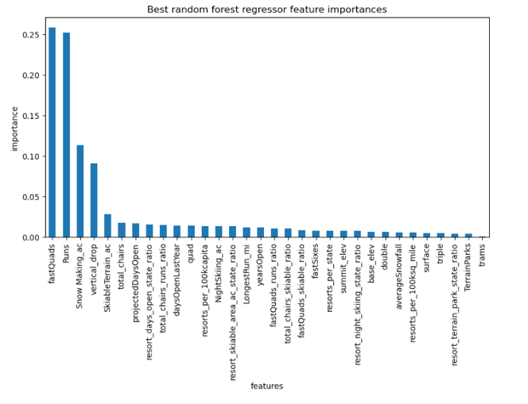
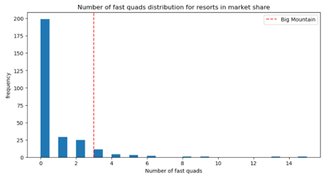
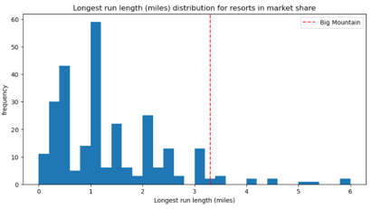
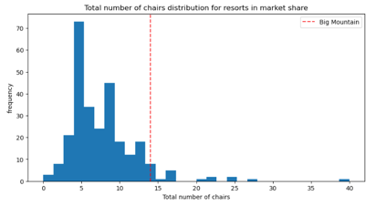
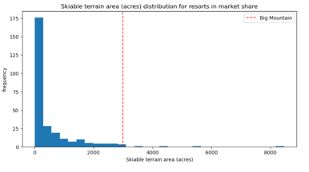
BMR Outshines the Others in Top Resort Features
Snow Making Machine
Vertical Drop
Runs
Fast Quads
Overall Top Resort Features Fast Quads*, Runs, Snow Making Machine, Vertical Drop
BMR in Comparison Big Mountain Resort’s features (defined by the red line) are mostly above average in comparison to the other resorts. The top features are labeled.
Note: There are missing data and inaccuracies within the provided data. *FastQuads data had too many missing fields, so we had to remove it from the analysis moving forward.

Slide 5
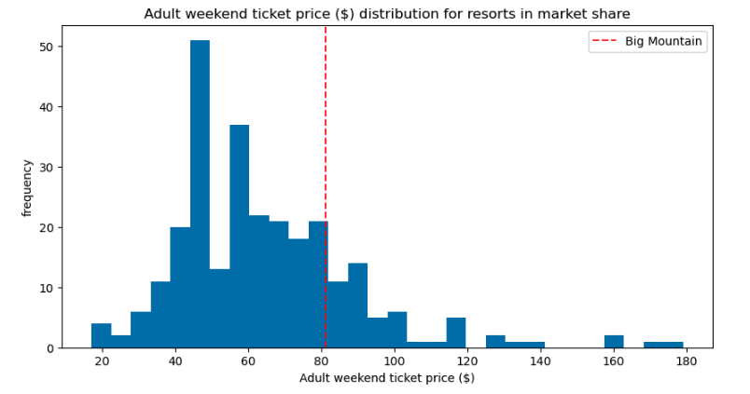
Increase Ticket Pricing
Increase Ticket Pricing
Based on BMR’s facilities and how it compares to the marketplace (both statewide and nationwide), there is significant room ($10) for increase in ticket pricing.
Big Mountain Resort currently charges $81 for a ticket, putting the new recommended price at $91.
The additional operating cost of the new chair lift per ticket is $1.54M. Assuming each visitor buys 5 day tickets, the increase in revenue at the new ticket price totals to $17.5M.
Note: There are missing data and inaccuracies within the provided data. *There were many missing fields in the Adult Weekday Price, so we based our analysis solely off of Adult Weekend Prices. Please keep in mind that because there are errors within the data, our estimates are subject to this uncertainty and could be the reason why the modeled price is so much higher than the current price. If data can be checked and updated, we can rerun the model with that information for more accurate analysis.

Slide 6
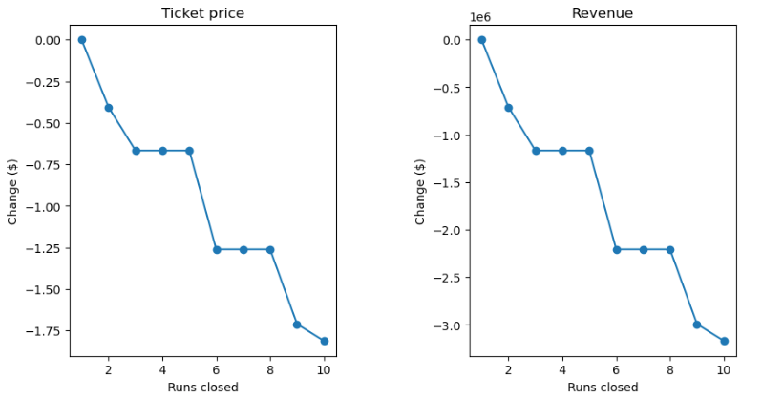
Change the Number of Runs
One Run Closure
To save on expenses, Big Mountain Resort could potentially close 1 of the underutilized runs, but no more. Closing 1 run would not make a difference in terms of ticket price in comparison to the marketplace, however, we do not recommend closing more than 1 as the more runs closed, the worse for the revenue.
Adding An Additional Run
Alternatively, adding an additional run (increasing the vertical drop by 150 feet) will support an increase in the ticket price by $8.61, which amounts to an overall seasonal increase by $15M. Based on our modeling, there is no need to add additional snow making machines for this scenario.
Note: There are missing data and inaccuracies within the provided data. *There were many missing fields in the Adult Weekday Price, so we based our analysis solely off of Adult Weekend Prices. Please keep in mind that because there are errors within the data, our estimates are subject to this uncertainty and could be the reason why the modeled price is so much higher than the current price. If data can be checked and updated, we can rerun the model with that information for more accurate analysis.

Slide 7
In Summary
Our team did find inaccuracies within the provided data. Many values were missing and some values were wrong. It would be greatly appreciated if you could revisit the data and if there is opportunity to gather more, it would help us build more accurate models for better recommendations and insight. Additional data that would be useful are the actual number of visitors at the resorts by year, operating costs of features, machinery costs (i.e. snow-maker).
We have built models to help you access how Big Mountain Resort compares in all aspects of features and pricing. Your team will have access to use these models to test new combinations of parameters. We will provide these models in a notebook for your analysts to use.
Overall, Big Mountain Resort is in a great place. The operating costs of the additional chairlift can easily be covered. Not only that, because of where it stands in comparison to the marketplace, Big Mountain Resort could be seeing a significant increase of additional revenue based on small adjustments.

